Slide 1
Set identities & bit strings
Sabina irum

Slide 2
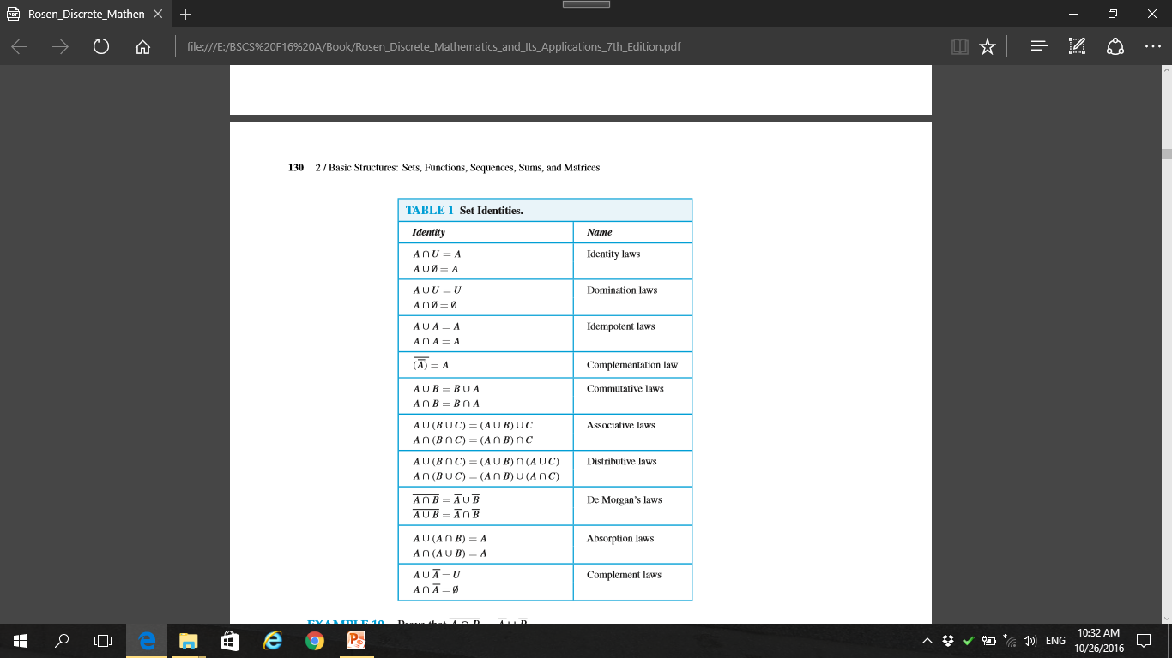

Slide 3
Set Identities
We can prove set identities mentioned in table 1 in three ways:
Membership table
Venn Diagram
Set Builder notation

Slide 4
Membership table

Slide 5
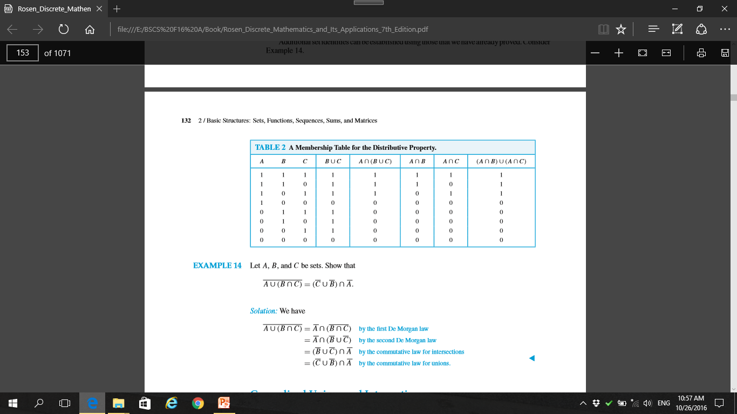
Prove Distributive Law

Slide 6
VENN DIAGRAM

Slide 7

Prove De Morgan law using Venn Diagram
One informal way of 'proving' an identity is to draw Venn diagrams for each side of the '=' and show they are the same.
e.g. 2nd De Morgan Law:
A
B
?
A
B
=
U
U

Slide 8
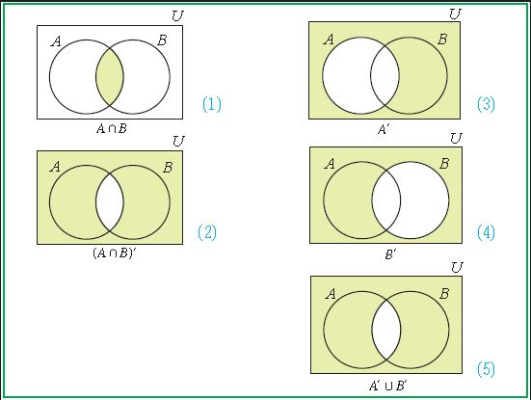
solution

Slide 9
SET BUILDER NOTATION

Slide 10
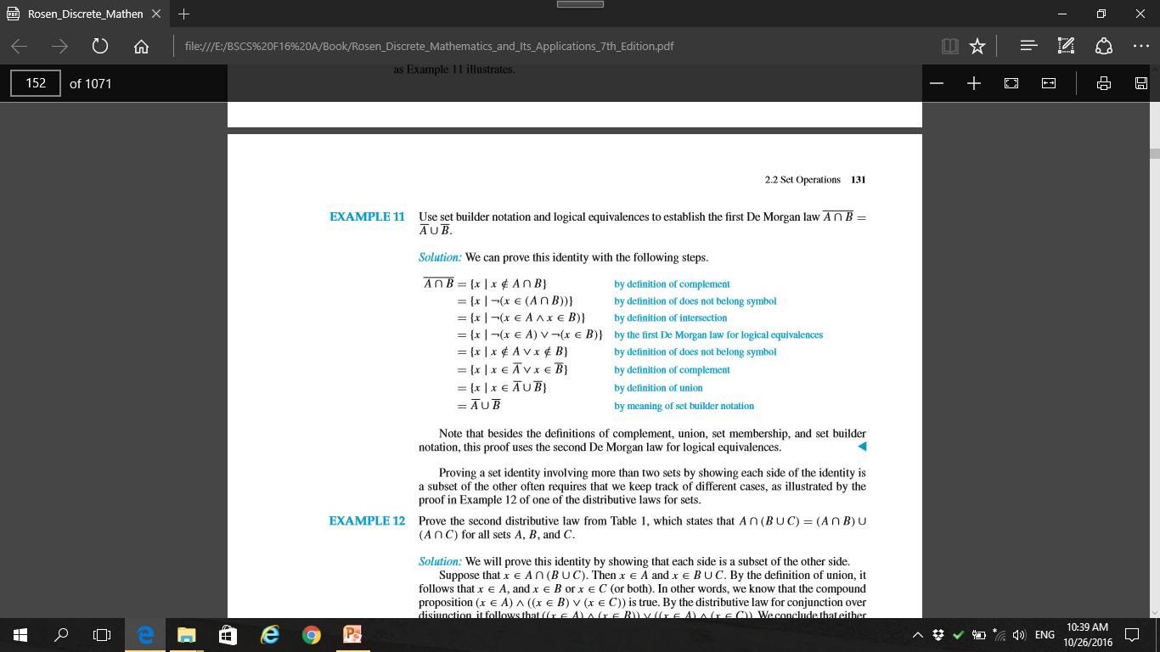
Prove De Morgan law A∩B = A∪B.

Slide 11
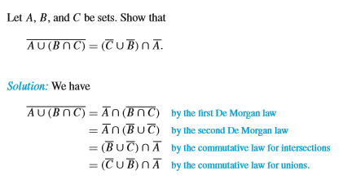
Example 1

Slide 12
Computer Representation of Sets
Method for storing elements using an arbitrary ordering of the elements of the universal set.
Specify an arbitrary ordering of the elements of U, for instance a1, a2, . . . , an.
Represent a subset A of U with the bit string of length n, where the ith bit in this string is 1 if ai belongs to A and is 0 if ai does not belong to A.

Slide 13
Example 2
Let U ={ 1,2,3,4,5,6,7,8,9,10}, and the ordering of elements of U has the elements in increasing order; that is, ai = i.
What bit strings represent the subset of all odd integers in U?
the subset of all even integers in U?
Subset of integers not exceeding 5 in U?

Slide 14
Example 2 Solution
Sol 1: The bit string that represents the set of odd integers in U, namely,{1,3,5,7,9} as:
10 1010 1010.
Sol 2: We represent the subset of all even integers in U, namely,{2,4,6,8,10}:
01 0101 0101
Sol 3: Subset of integers not exceeding 5 in U?
11 1110 0000

Slide 15
Complement using bit strings
We have seen that the bit string for the set {1,3,5,7,9} (with universal set {1,2,3,4, 5,6,7,8,9,10}) is 10 1010 1010.
What is the bit string for the complement of this set?
01 0101 0101

Slide 16
Union and Intersection using bit strings
11 1110 0000 and 10 1010 1010
What is union of 2 sets?
11 1110 0000∨10 1010 1010=11 1110 1010
What is intersection of 2 sets?
11 1110 0000∧10 1010 1010=10 1010 0000,

Slide 17
Example
1. Let A be the set of students who live within one mile of school and let B be the set of students who walk to classes. Describe the students in each of these sets.
A ∩ B
A ∪ B
A − B
B − A
Notes:
a) The set of students who live within one mile of school and walk to classes
b) The set of students who live within one mile of school or walk to classes (or do both)
c) The set of students who live within one mile of school but do not walk to classes
d) The set of students who walk to classes but live more than one mile away from school

Slide 18
Questions
3. Let A ={1, 2, 3, 4, 5} and B ={0, 3, 6}.
Find a) A ∪ B.
b) A ∩ B.
c) A − B.
d) B − A.
Notes:
3. a) {0,1,2,3,4,5,6}
b) {3}
c) {1, 2, 4,5}
d) {0, 6}

Slide 19
17. Show that if A, B, and C are sets, then A ∩ B ∩ C =
A ∪ B ∪ C
a) by showing each side is a subset of the other side.
b) using a membership table.

Slide 20
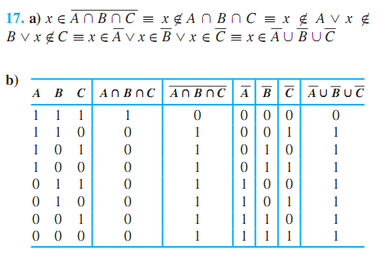

Slide 21
19. Show that if A and B are sets, then
a) A − B = A ∩ B.
b) (A ∩ B) ∪ (A ∩ B) = A.
Solution :
a) Both sides equal {x | x ∈ A∧x ∈ B}.
b) A = A∩U
=A∩ (B ∪ B)
= (A∩ B) ∪ (A∩ B)

Slide 22
21. Prove the ﬁrst associative law from Table 1 by showing that if A, B, and C are sets, then A ∪ (B ∪ C) =
(A ∪ B) ∪ C.
Solution :
x ∈ A∪ (B ∪ C)
≡(x ∈ A) ∨ (x ∈ (B ∪ C))
≡ (x ∈ A) ∨ (x ∈ B ∨ x ∈ C)
≡ (x ∈ A ∨ x ∈ B) ∨ (x ∈ C)
≡ x ∈ (A ∪ B) ∪ C

